Slide 1

STAT4011 Project 1
Forecasting Shanghai House Price
Group 11
DAI Qiyu 1155141616
CHEN Taoyue 1155141543
JIANG Yun Hui 1155141677
LI Linyuan 1155141569
MAK Man Fung 1155141893
QIN Zihao 1155124920

Slide 2

Introduction

Slide 3
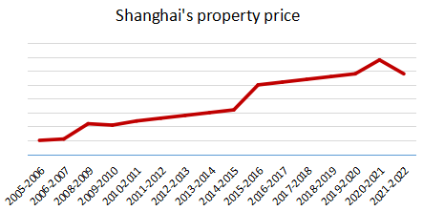


Introduction
Motivation
The second-hand property price increased significantly in Shanghai
Difficult for buyers and sellers to estimate price of second-hand property

Slide 4

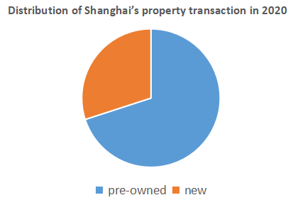

Introduction
Motivation
Objective
Utilize Shanghai second hand property dataset from Lianjia to
1. Forecaste the price of second hand property by using regression analysis
2. Identify factors which influence the price significantly

Slide 5
Contents
1
20%
Introduction
2
Data-preprocessing
40%
3
Regression Analysis
60%
4
Variable Importance
80%
5
Conclusion
100%

Slide 6
2. Data-preprocessing

Slide 7
Data-preprocessing
Data Description
Data Source
We use python to automatically scrap it from Lianjia.com
Advantage of our data
1. Large Volumn - 21299 records, each described by 22 features
2. Updated - on the market of the nearest twenty days
80%
Training dataset
Data Splitting
Randomly select
20%
Testing dataset

Slide 8
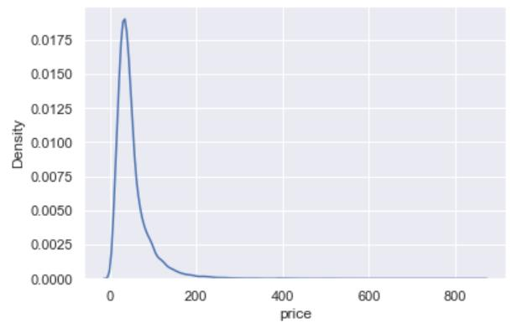
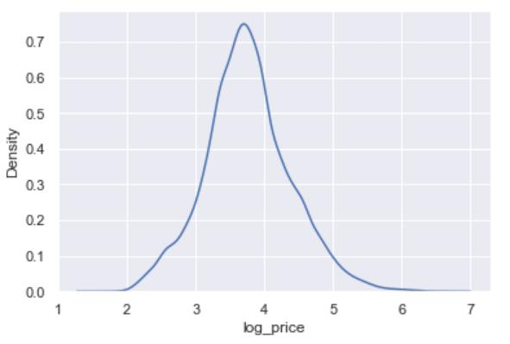
Data-preprocessing
Visualization
Density plot of price
Using log-transformation to reduce the skewness
Take log

Slide 9
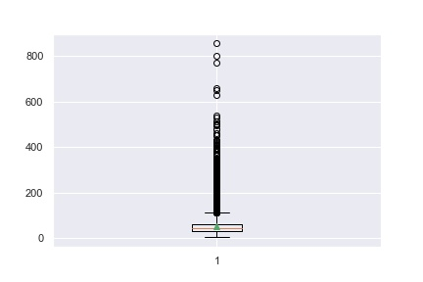
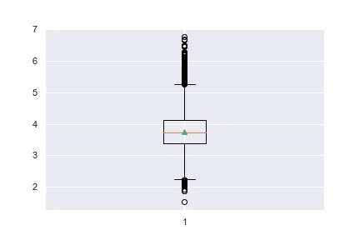
Data-preprocessing
Visualization
Density plot of price
Bloxplot for Price
The number of outliers is reduced after log-transformation

Slide 10
Data-preprocessing
Data Transformation
Dummy encoding for 15 categorical features -> 63 dummy factors
A categorical variable with n features -> (n-1) dummy variables
Extraction from 7 columns of text data -> 12 numerical features
E.g: extracting (5, 2, 1, 2) from text information “five rooms two living rooms one kitchen two toilets”
Bloxplot for numerial features
id | X
1 | a
2 | b
3 | c
id | a | b
1 | 1 | 0
2 | 0 | 1
3 | 0 | 0
Dummy
encoding

Slide 11
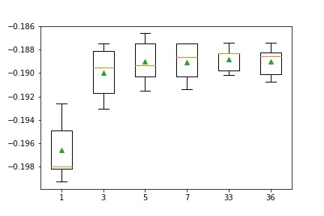
Data-preprocessing
Missing data imputation
Summarizing missing data
1. Proportion of missing data is small or zero
2. Imputation is still needed to avoid a waste of information
Missing data imputation
1. Pin down optimal hyperparameter with a pipeline consisting of
(1) KNN imputer (2) random forest regressor in a five-fold cross validation process
2. Fit the KNN imputer on training data and then apply to testing data

Slide 12
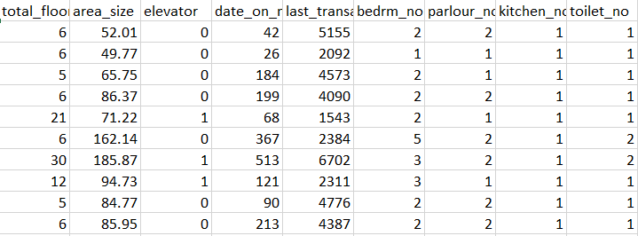
Data-preprocessing
Standardization
Data standardization
Scale of numerical features differ greatly
Data standardization
Use the mean and variance from training data to perform standarization

Slide 13
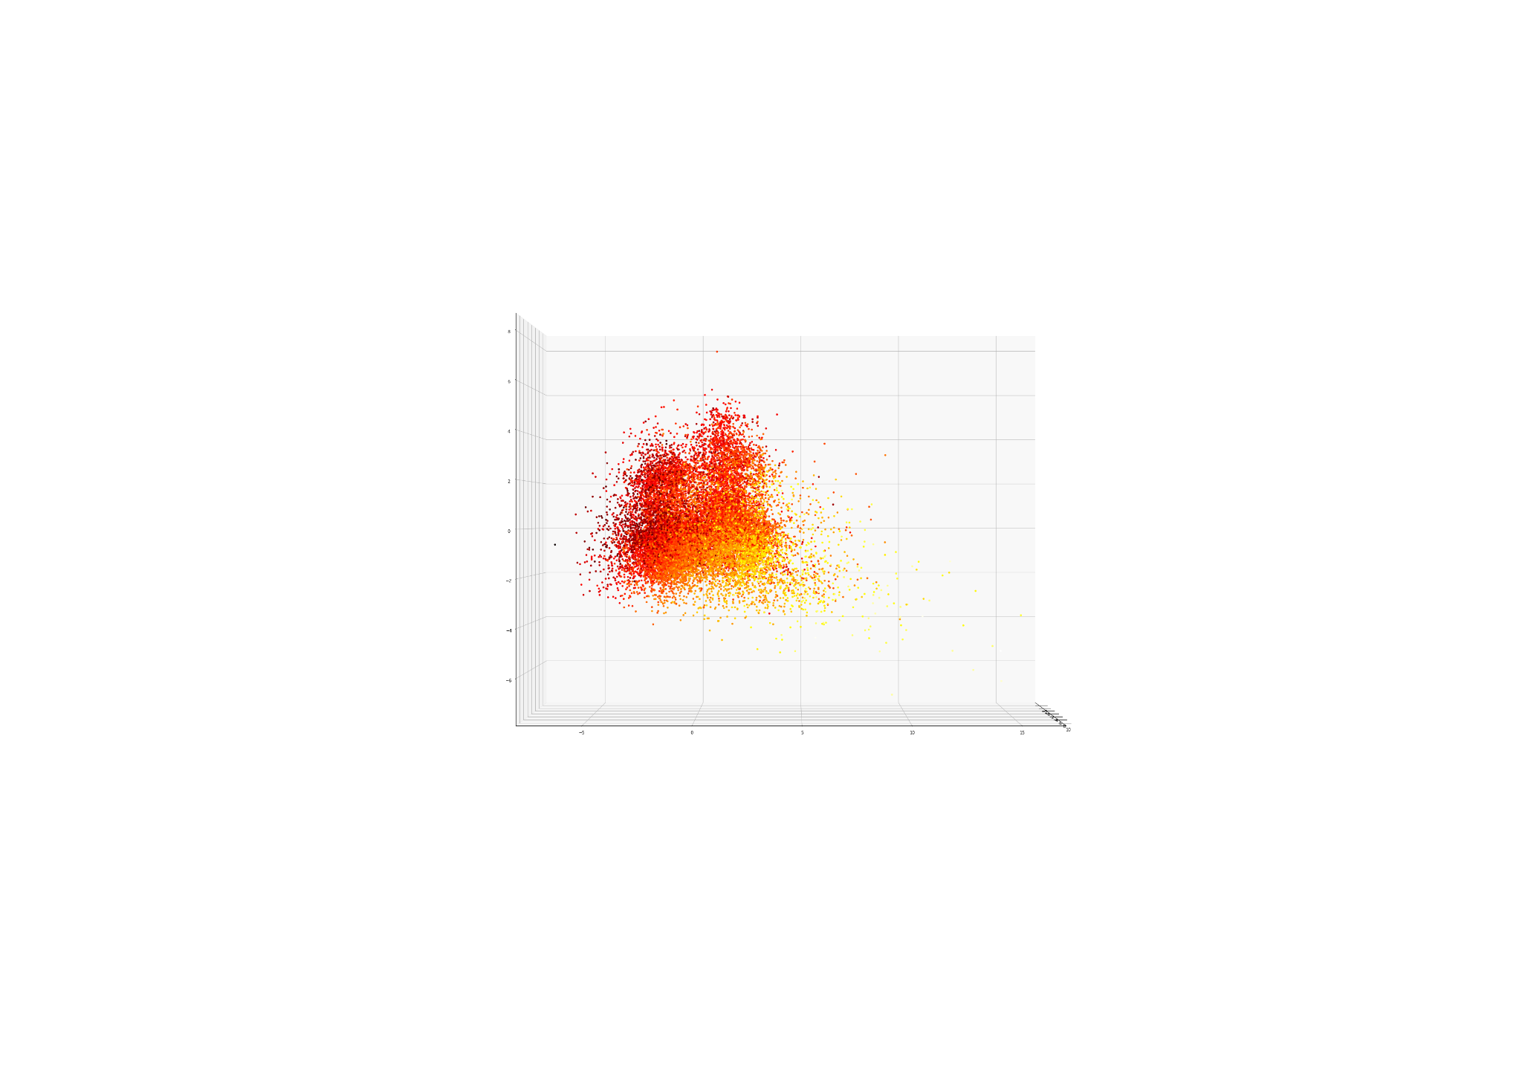
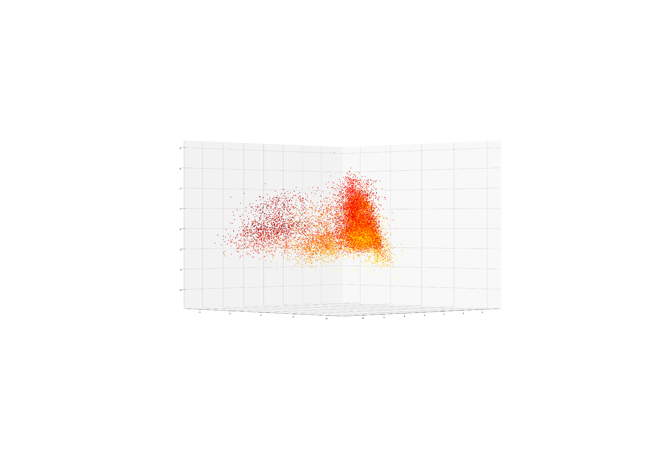
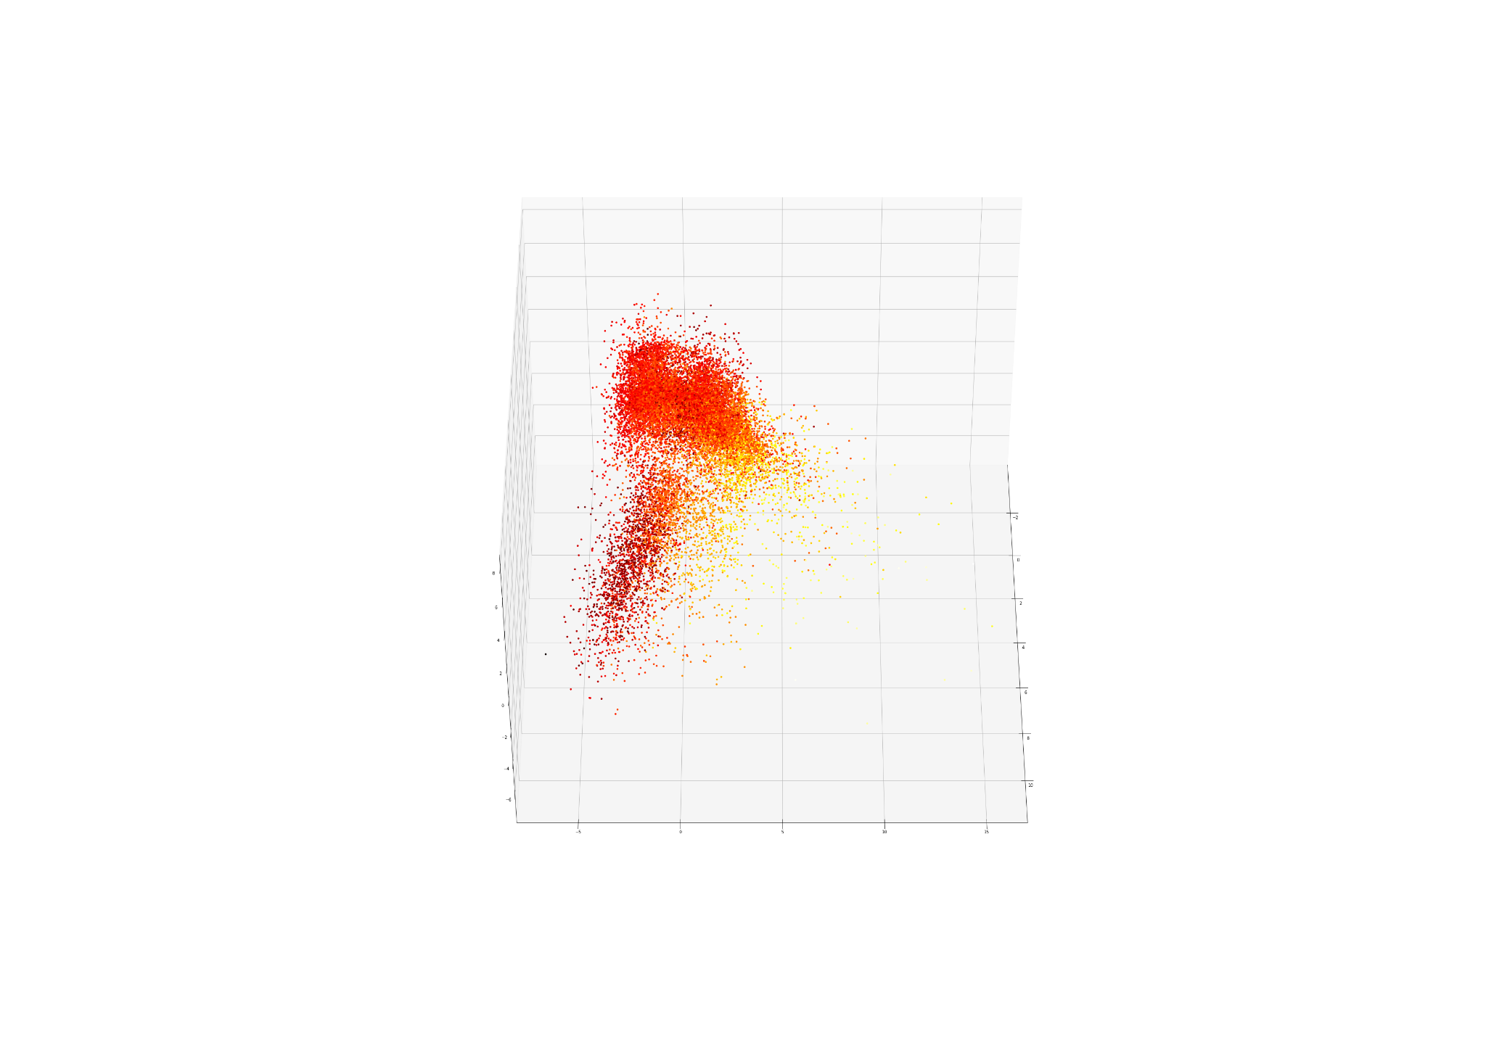
Data-preprocessing
Further visualization
[min(y), max(y)]
Explanantion
Apply PCA to project the dataset to a three-dimensioanl space
Looking it from three angles, our data is well-separated

Slide 14
3. Regression Analysis

Slide 15
Regression Analysis
Model Selection Strategies
Model Selection
Select model with optimal complexity by 5-folds cross-validation
Main Workflow
Model Training
Fit all training observations with selected model
Model Evaluation
Assess the goodness of model on new data points with testing set

Slide 16

Regression Analysis
Model Selection Strategies
Parameter selection
Adjust parameter condidate sequence:
the picked one lies in the middle of set ( instead of boundary)
Computation Speed
Allow python to do parallel computing for acceleration
Bloxplot for numerial features
until
❌
1 | 2 | 3 | 4
 | 2 | 3 | 4 | 5
Optimal
Parameter

Slide 17
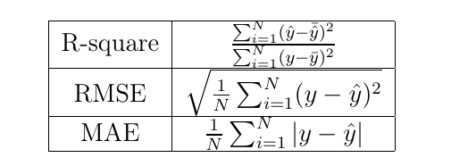
Regression Analysis
Model Evaluation Strategies
R-Square
How well the model explains the variation of target variable
Root-Mean-Squared Error (RMSE) and Mean-Absolute-Error
How deviate our prediction from the truth
Shares the same unit of dependent variable
Bloxplot for numerial features

Slide 18
OLS
Results
Bloxplot for numerial features
Advantage
Drawback
Computationally efficient
Easily undertstand
VS
Inflexibility：imposed linear restrictions
 | R-square | RMSE | MAE
Training | 0.8516 | 0.2476 | 0.1886
Testing | 0.8450 | 0.2557 | 0.1948
Not Satisfactory

Slide 19
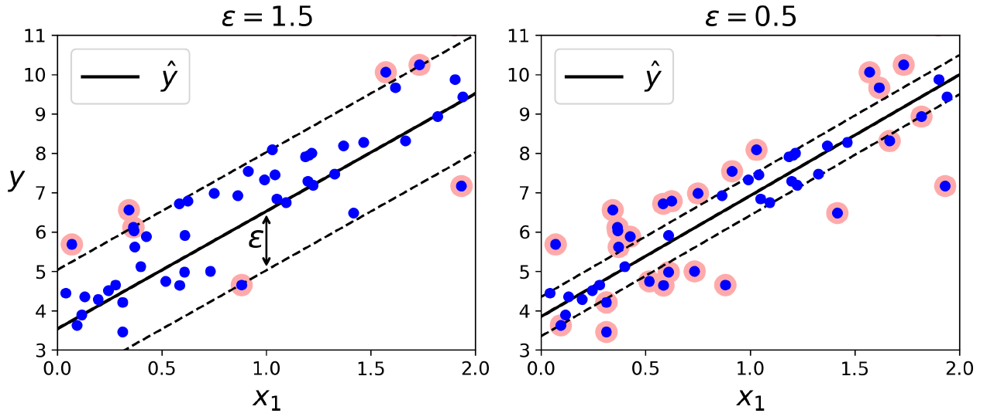
Support Vector Machine Regression
Principle
Fit more instances on the street along the hyperplane
Grid Search Using 5-folds cross-validation
The kernel function controls non-linearity
Radial basis function kernel is selected
Bloxplot for numerial features

Slide 20
Support Vector Machine Regression
Results
Better than OLS
Slightly overfit
 | R-square | RMSE | MAE
Training | 0.9429 | 0.1535 | 0.1134
Testing | 0.8888 | 0.2166 | 0.1541

Slide 21
K-Nearest Neighbor Regression
Advantage
Non-parametric in the sense that the number of parameters is unrestricted
Grid Search Using 5-folds cross-validation
The most crucial parameter: K=1
Results
Severe overfitting problem
 | R-square | RMSE | MAE
Training | 1.0 | 0.0 | 0.0
Testing | 0.7901 | 0.2976 | 0.2271

Slide 22
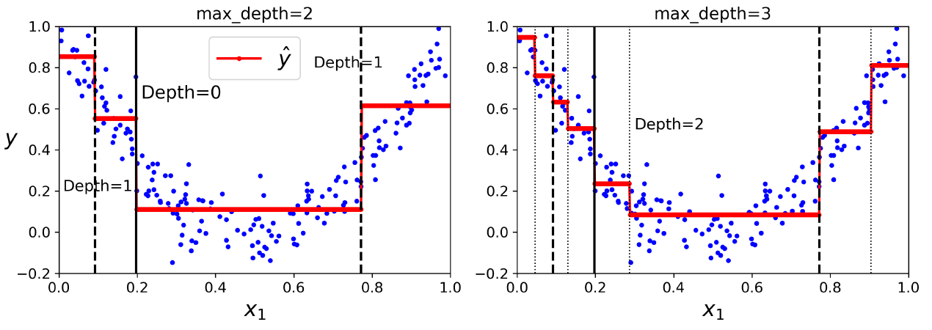
Decision Tree Regression
Bloxplot for numerial features
Advantage
Flexible：piecewise decision boundary
Robust： not sensitive to outliers

Slide 23
Decision Tree Regression
Grid Search Using 5-folds cross-validation
Depth of tree should be selected
Otherwise, python will split data until only pure leaf nodes left
We also tuned 4 other paramaters
E.g., number of features to consider when looking for the best split
Results
 | R-squared | RMSE | MAE
Training | 0.9206 | 0.1811 | 0.137
Testing | 0.8741 | 0.2305 | 0.1679

Slide 24
Decision Tree Regression
Results
Limitations
Variance - Solve by Random Forest
Gap between training and testing accuracy
Bias - Solve by Boosting Algorithms
There is still space to improve model fitting
 | R-squared | RMSE | MAE
Training | 0.9206 | 0.1811 | 0.1370
Testing | 0.8741 | 0.2305 | 0.1609

Slide 25
Random Forest
Principle
Pass data points by each tree trees and average the result
Grid Search Using 5-folds cross-validation
Random forest is hard to overfit
Tuning the tree depth is not rewarding; Set to be 30 here.
number of features used in each tree, number of trees in the whole forest
Results
 | R-squared | RMSE | MAE
Training | 0.9892 | 0.0667 | 0.0484
Testing | 0.9172 | 0.187 | 0.1345

Slide 26
Boosting Algorithms
Principle
Ada Boosting
Grow additional trees, assigning higher weight to instances with larger error before
Gradient Boosting
Add at each step a new decision tree that best reduces the loss function before
XGB Boosting
Regularization could be implemented compared with Gradient boosting
Grid Search Using 5-folds cross-validation
We tuned learning rate for all of these three models
There are also other paramters selected
Bloxplot for numerial features

Slide 27
Boosting Algorithms
Results
Ada and XGB
are excellent
Gradient boosting
overfits
 | R-squared | RMSE | MAE
Ada (training) | 0.9998 | 0.0101 | 0.0029
Ada (testing) | 0.9191 | 0.1848 | 0.1269
Gradient (training) | 0.9954 | 0.0436 | 0.0336
Gradient (testing) | 0.8583 | 0.2445 | 0.1709
XGB (training) | 0.9867 | 0.0742 | 0.0584
XGB (testing) | 0.9197 | 0.1841 | 0.1334

Slide 28
Overall Comparison
Results on Testing Data
 | R-squared | RMSE | MAE
OLS | 0.8450 | 0.2557 | 0.1948
KNN | 0.7901 | 0.2976 | 0.2271
SVR | 0.8888 | 0.2166 | 0.1541
Decision Tree | 0.8741 | 0.2305 | 0.1697
Random Forest | 0.9172 | 0.1870 | 0.1345
Ada boosting | 0.9191 | 0.1848 | 0.1269
Gradient boosting | 0.8584 | 0.2445 | 0.1709
XGB boosting | 0.9197 | 0.1841 | 0.1334

Slide 29
4. Variable Importance

Slide 30
Variable Importance
Criteria
Predictive power
In tree-based models, it is the reduction of node impurity
Based on the best three models mentioned before
Random forest, Ada boosting, XGB boosting
Bloxplot for numerial features
Results
Random forest and Ada boosting
Area-size (numerical), Inner (dummy), Office (dummy)
XGB boosting
Office, Jinshan (dummy), Nongming (dummy)

Slide 31
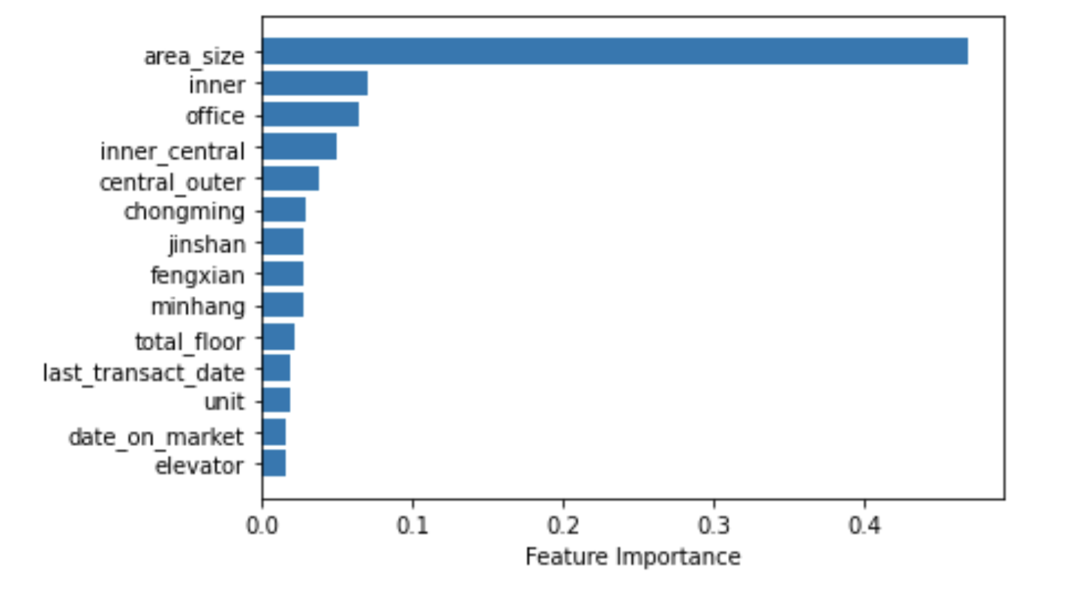
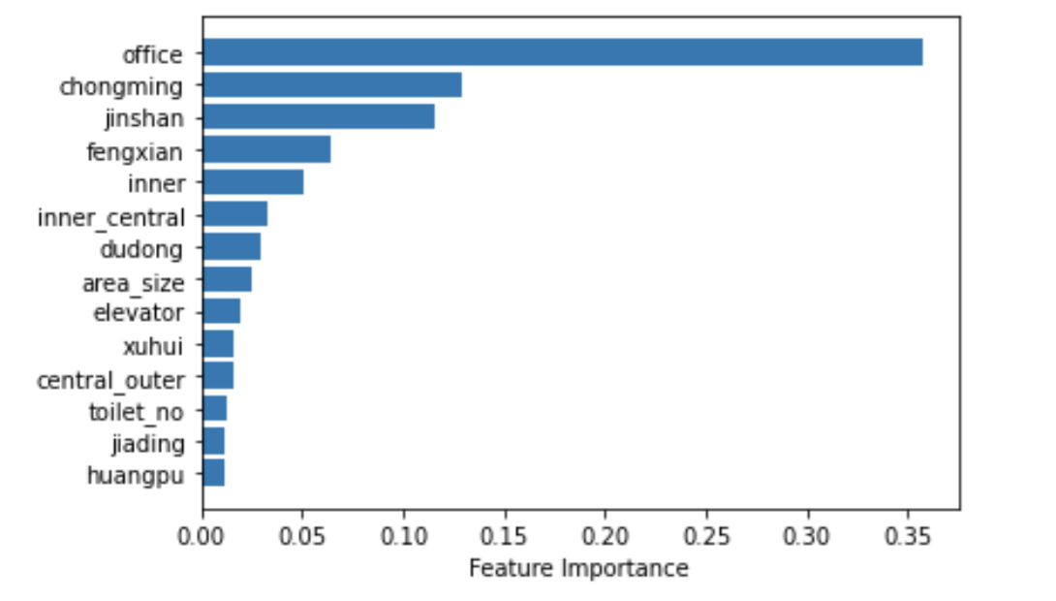
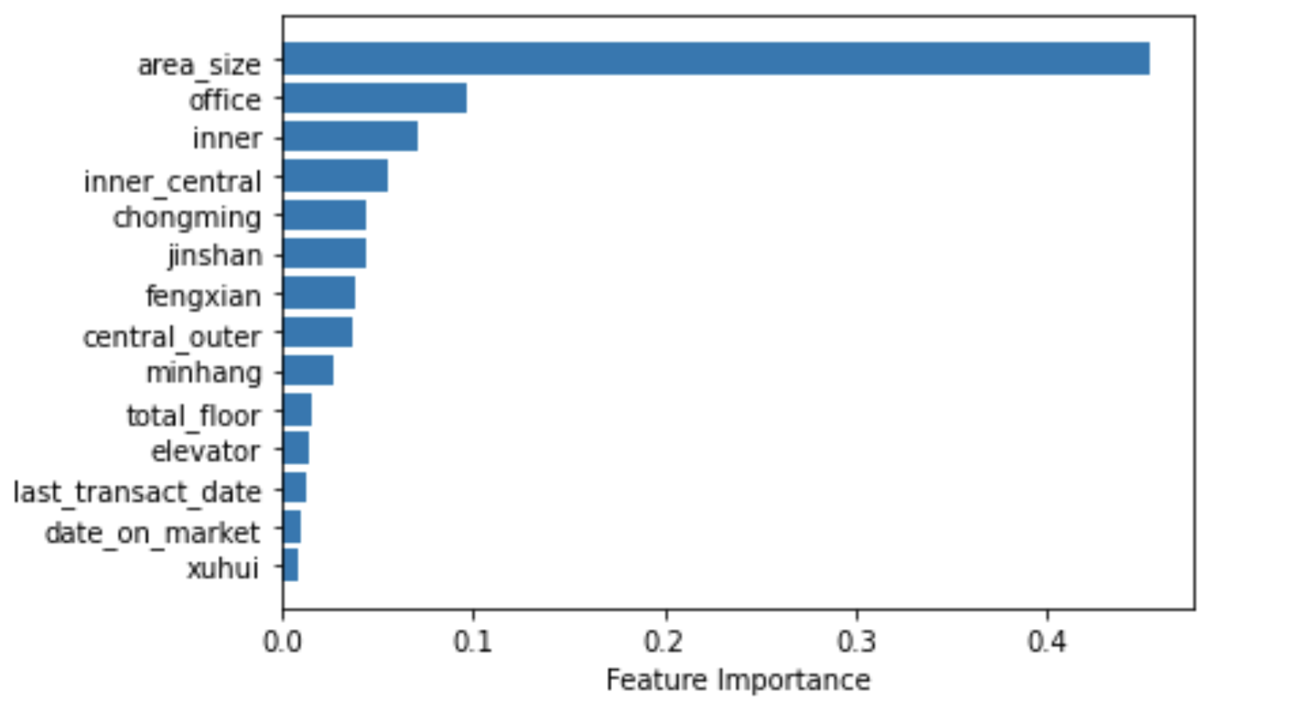
Variable Importance (Visualization)
XGB boosting
Ada boosting
Gradient boosting
area_size
office
area_size
inner
Nongming
inner
office
jinshan
office

Slide 32
5. Conclusion

Slide 33
Summary
Data
Second-hand house data scraped from Lianjia.com
Pre-Processing
Visualization, Cleaning, Transformation
Model Building
Our best model gives a R-squared around 0.92
Variable Importance
Variables with good explanatroy power are identified

Slide 34

Summary
Constraints
Bloxplot for numerial features
Text data processing requires Deep learning method, e.g., Comments and school district of apartments
Other factors to consider, e.g., government regulation and economic envirmment

Slide 35


Slide 36


